Slide 1

K-Map 2: Digital Fundamentals
Computer Organization and Architecture | Introduction to Digital Fundamentals
Computer Organization and Architecture | Introduction to Digital Fundamentals | Bachelor of Engineering
DISCOVER · LEARN · EMPOWER
Notes:
Welcome everyone to today's session on K-Maps. We are diving deeper into the second part of Karnaugh Maps within our Digital Fundamentals chapter. This session is crucial for simplifying complex logic expressions efficiently. Remember, our motto at Chandigarh University is to Discover, Learn, and Empower through engineering excellence.

Slide 2
Course Outcomes
SLIDE 2 / 6
Course Outcome
CO | BT LEVEL | DESCRIPTION
CO1 | BT3 | Apply number systems and digital logic to design basic digital circuits
CO2 | BT4 | Analyze register organization and instruction set architecture
CO3 | BT3 | Implement computer arithmetic algorithms and floating-point operations
CO4 | BT5 | Analyze memory hierarchy and input-output organization
CO5 | BT6 | Evaluate control unit design and pipelining performance
Chandigarh University
2 / 6
Notes:
Today's lecture directly addresses Course Outcome 1. You will learn to apply number systems and digital logic to design basic digital circuits. Specifically, we will use K-Maps to minimize logic expressions, which is a fundamental step in circuit design. This skill ensures your designs are efficient and cost-effective.

Slide 3
Learning Objectives
SLIDE 3 / 6
Learning Outcomes
1
Identify essential prime implicants in four-variable K-Maps
2
Simplify Boolean expressions using don't care conditions effectively
3
Group adjacent cells to minimize the number of logic gates required
4
Analyze multiple valid solutions for the same logic function
Chandigarh University
3 / 6
Notes:
By the end of this lecture, you will be able to identify essential prime implicants in four-variable K-Maps. You will also learn to simplify Boolean expressions using don't care conditions effectively. We will practice grouping adjacent cells to minimize the number of logic gates required. Finally, you will analyze multiple valid solutions for the same logic function.

Slide 4
Lecture
SLIDE 4 / 6
Four-Variable K-Map Structure
1
A four-variable K-Map contains 16 cells representing all possible minterms from 0 to 15
2
Rows and columns follow Gray code sequence to ensure only one bit changes between adjacent cells
3
Groups of 1, 2, 4, 8, or 16 adjacent 1s can be formed to simplify the expression
4
Wrap-around adjacency allows the top row to connect with the bottom row and left with right
Chandigarh University
4 / 6
Notes:
A four-variable K-Map contains 16 cells representing all possible minterms from 0 to 15. Rows and columns follow Gray code sequence to ensure only one bit changes between adjacent cells. Groups of 1, 2, 4, 8, or 16 adjacent 1s can be formed to simplify the expression. Wrap-around adjacency allows the top row to connect with the bottom row and left with right, just like a torus.

Slide 5
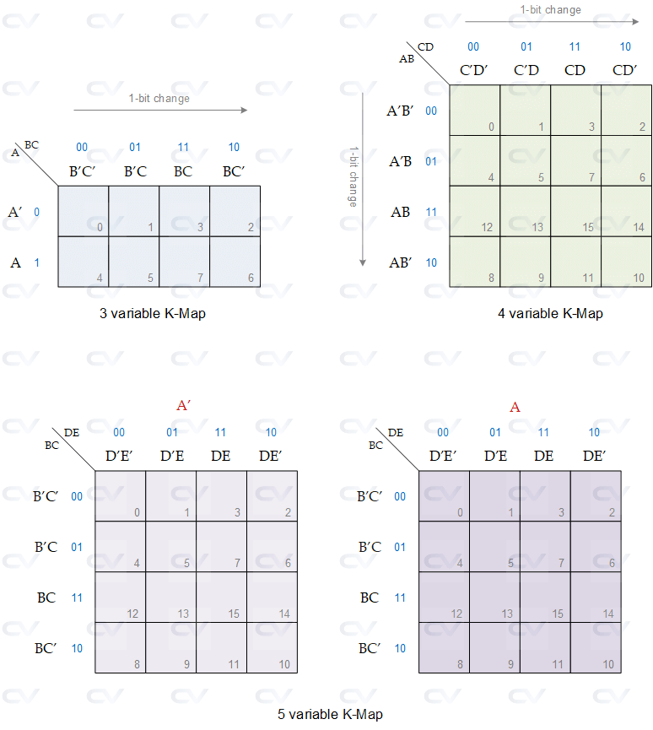
Worked Example
SLIDE 5 / 6
Simplification
GOVERNING EQUATION
Final simplified expression is F = B'D' + BD, which equals B XNOR D
1
Simplify F(A,B,C,D) = Σ(0, 2, 5, 7, 8, 10, 13, 15) using a four-variable K-Map
2
Group four 1s in corners (0, 2, 8, 10) yields term B'D'
3
Group four 1s in middle columns (5, 7, 13, 15) yields term BD
Karnaugh Maps (source: chipverify.com)
Chandigarh University
5 / 6
Notes:
Let's simplify F(A,B,C,D) = Σ(0, 2, 5, 7, 8, 10, 13, 15) using a four-variable K-Map. We group four 1s in corners (0, 2, 8, 10) which yields term B'D'. We also group four 1s in middle columns (5, 7, 13, 15) which yields term BD. The final simplified expression is F = B'D' + BD, which equals B XNOR D, saving us significant hardware.

Slide 6
Lecture
SLIDE 6 / 6
References
COMPUTER ORGANIZATION AND DESIGN
The Hardware/Software Interface — David A. Patterson, John L. Hennessy
COMPUTER ARCHITECTURE
A Quantitative Approach — John L. Hennessy, David A. Patterson
• Computer Organization and Architecture — William Stallings
• Computer System Architecture — M. Morris Mano & Rajib Mall
• Computer Organization — Carl Hamacher, Zvonko Vranesic, Safwat Zaky
Chandigarh University
6 / 6
Notes:
For further reading, please refer to the standard texts listed on this slide. William Stallings and M. Morris Mano provide excellent foundational knowledge on digital logic. David A. Patterson and John L. Hennessy offer deep insights into hardware-software interfaces. These resources will support your understanding of K-Maps and digital circuit design.

